Slide 1
PRESENTATION FOR GAME IDEA
(SU-DO-KU)
PROGRAD:
Anamika Gupta
Date-23/02/2020
UNDER SUPERVISION OF :
Kannan sir (Face_prep)

Slide 2
The Idea:
1. This game is based on javascript.
2. It is basically a number based game.
3. Sudoku is a puzzle game designed for a single player, much like a crossword puzzle.
4. The puzzle itself is nothing more than a grid of little boxes called “cells”. They are stacked nine high and nine wide, making 81 cells total.
5. Sudoku is a logic-based, combinatorial number-placement puzzle.
6. The objective is to fill a 9×9 grid with digits so that each column, each row, and each of the nine 3×3 subgrids that compose the grid contain all of the digits from 1 to 9.

Slide 3
BENEFITS:
Improves your memory. Memory and logic work side-by-side when you are playing Sudoku.
2. Stimulates your mind.
3. Reduces the chances Of developing Alzheimers by keeping your brain active.
4. Learns to do things quickly.
5. Increases your concentration power.
6. Feel Happy.

Slide 4
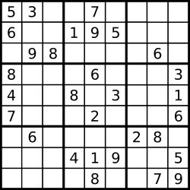
STRUCTER OF SU-DO-KU

Slide 5
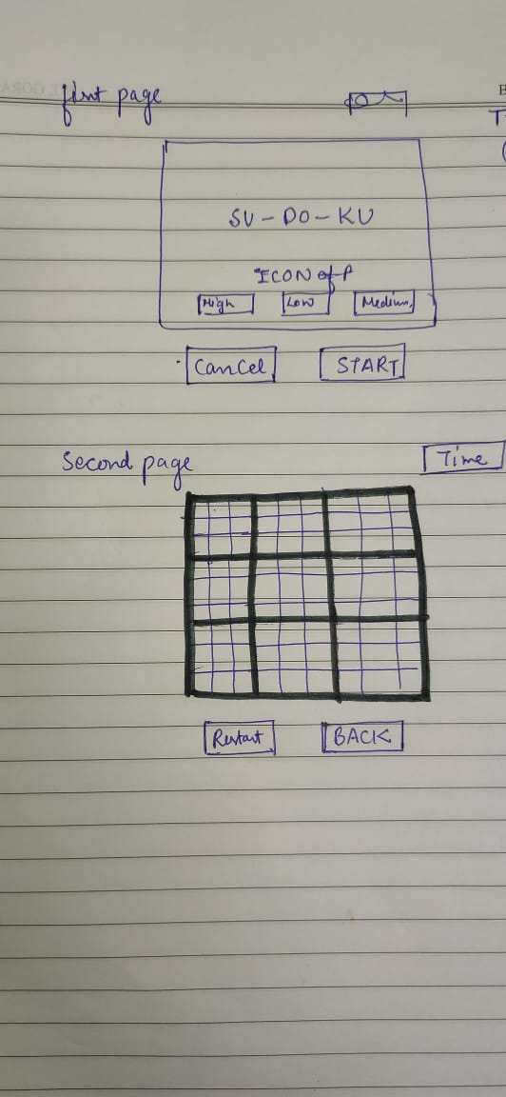

Slide 6
THANK YOU

